Slide 1
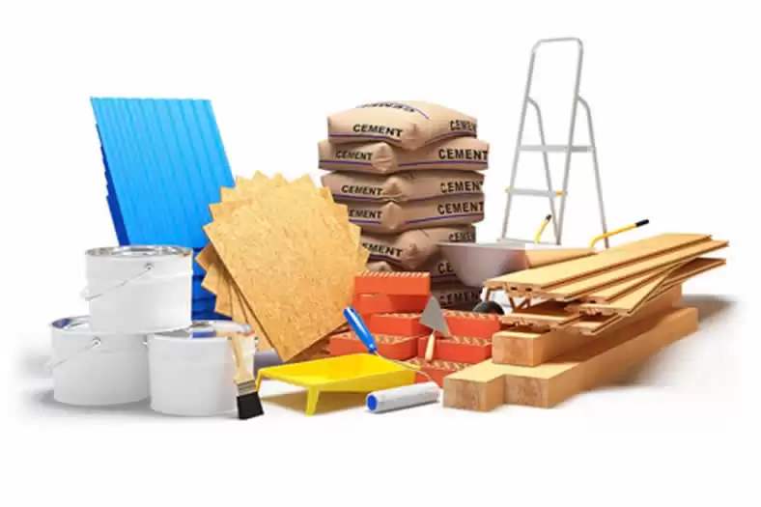

Halcon
CONSTRUCTION APP
MONSERRAT GOMEZ ESTRADA
ADRIAN ALEJANDRO MARTINEZ RAMIREZ
JORGE SERRANO MURRIETA
YAACOB JAYIN GARCIA BLANCAS
FERNANDO MORALES ROMERO

Slide 2

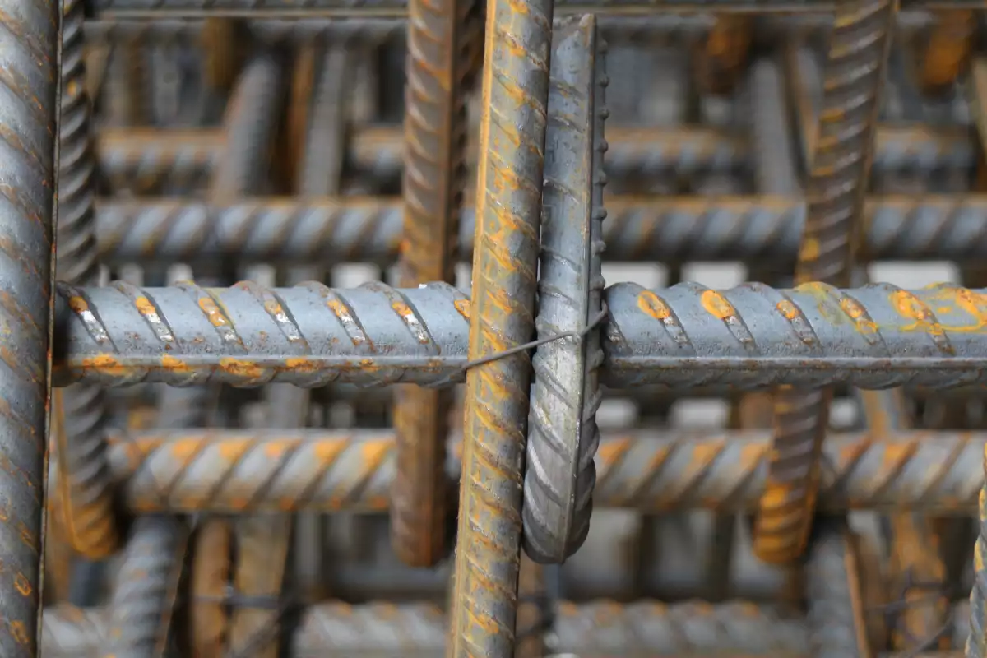
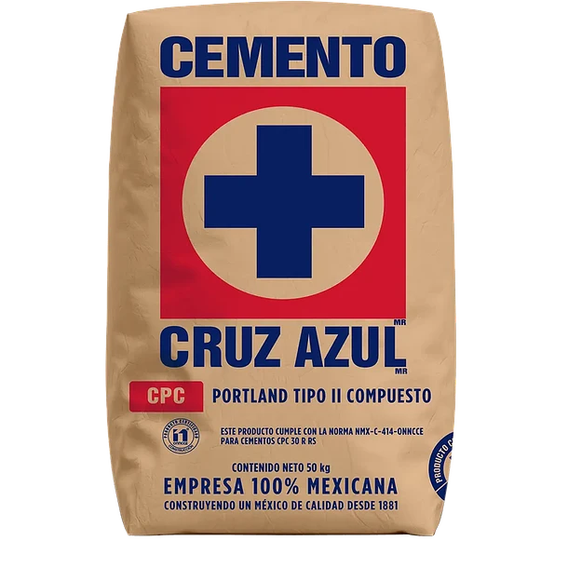
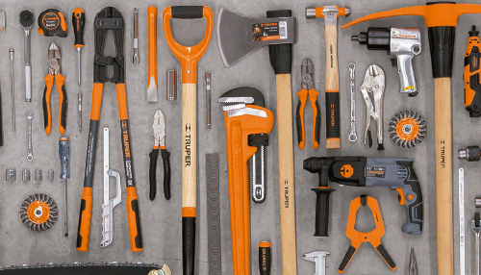
A friendly and secure website
Our website is designed with the highest security standards to ensure a reliable shopping experience.
In addition, we implement authentication and encryption systems to prevent unauthorized access. Navigation is intuitive and transparent, with clear information on products, prices and availability.
With constantly updated protection measures, our website offers a safe environment to purchase construction materials quickly and reliably.

Slide 3
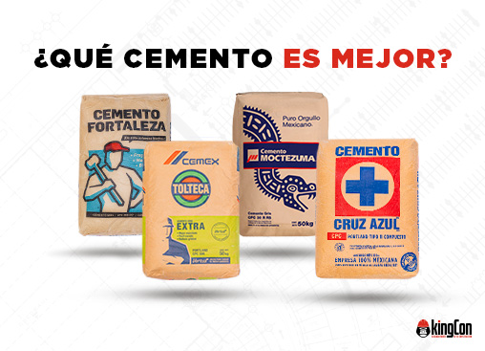
BASIC MATERIALS
CEMENT
Fine powder that, when mixed with water, sand and gravel, forms concrete.
It acts as a binder, binding the other materials together.
Cemex
Cruz Azul
Cementos Moctezuma
Holcim Apasco

Slide 4
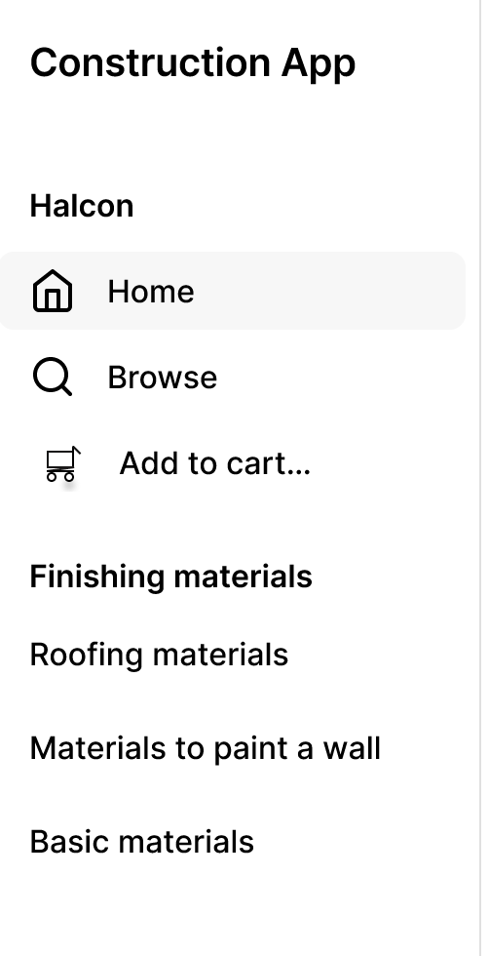
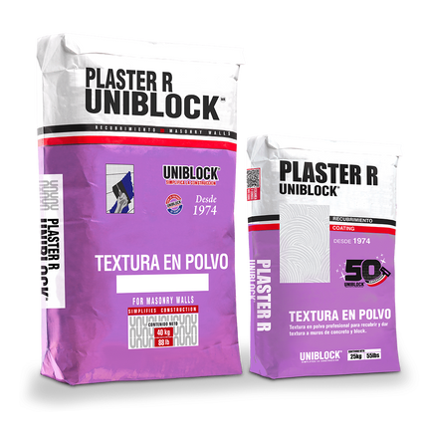
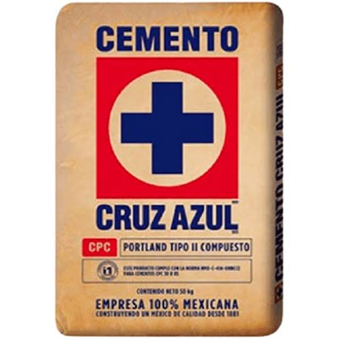
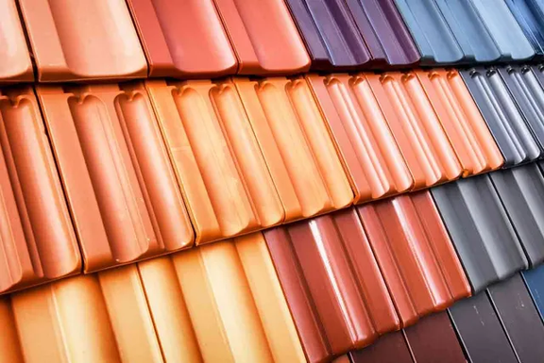

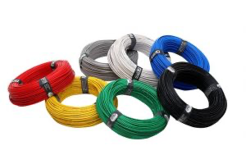
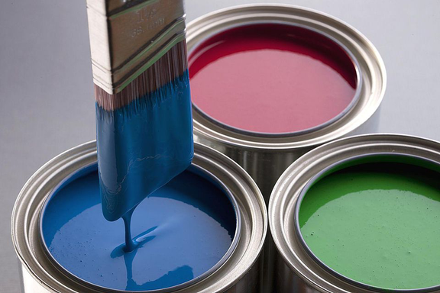
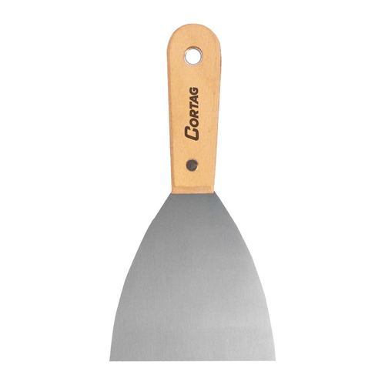
Plaster
Product Code: 1173076789
$ 295
Cement
Product Code: 1173079133
$ 250
Roof tiles
Product Code: 5673079133
$ 550
Plaster
Product Code: 1983079133
$ 300
Paint
Product Code: 3123079133
$ 195
Spatula
Product Code: 1198079133
$ 100

Slide 5





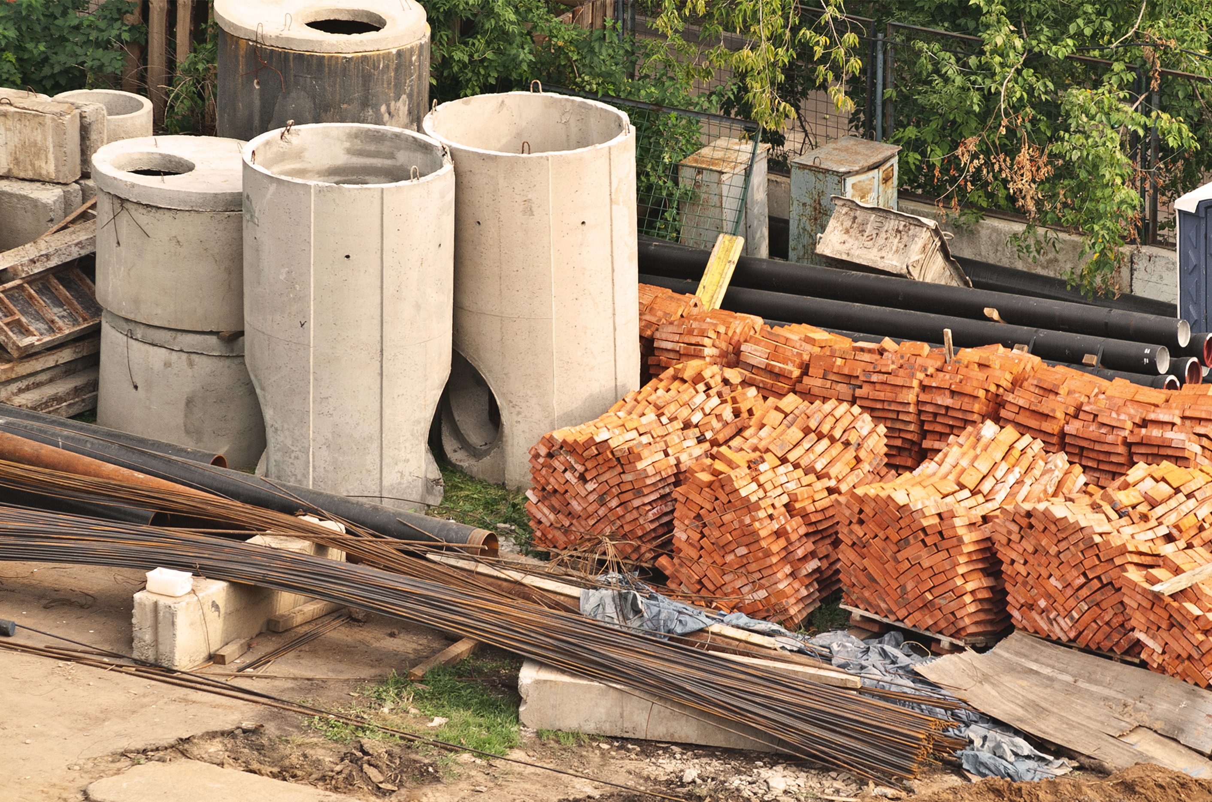
choose your state
continue
Basic materials
Finishing materials
Roofing materials
Materials to paint a wall

Slide 6
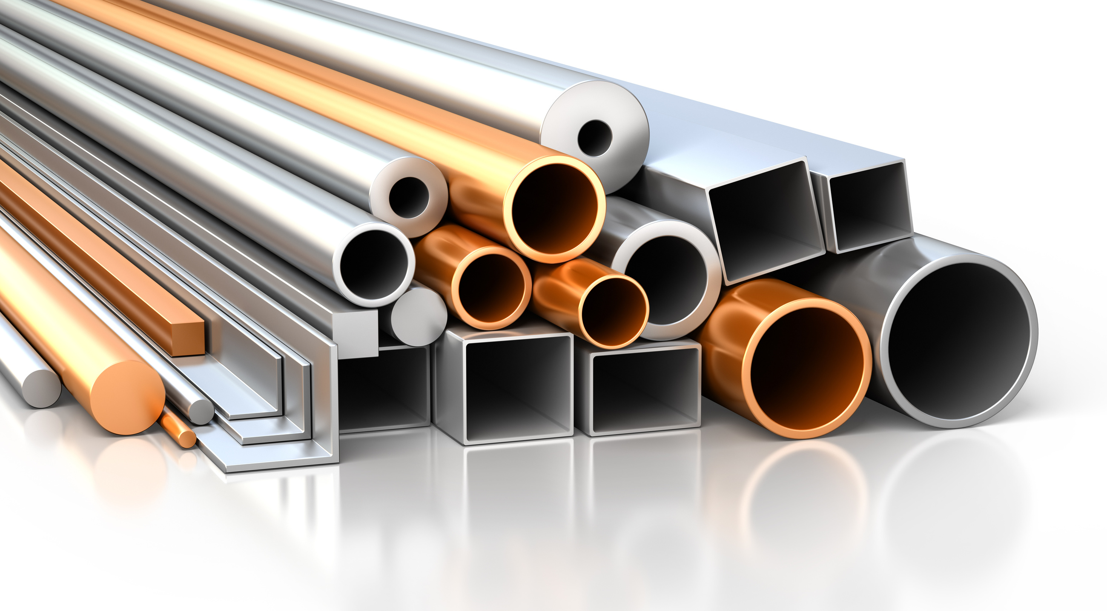

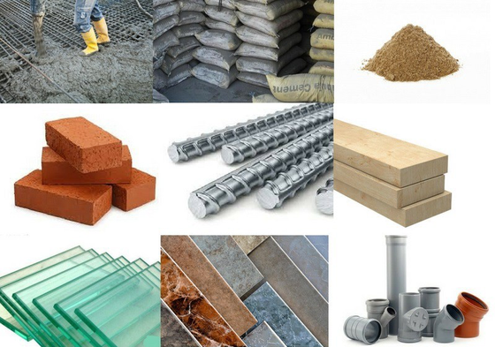
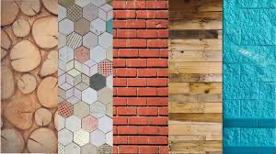
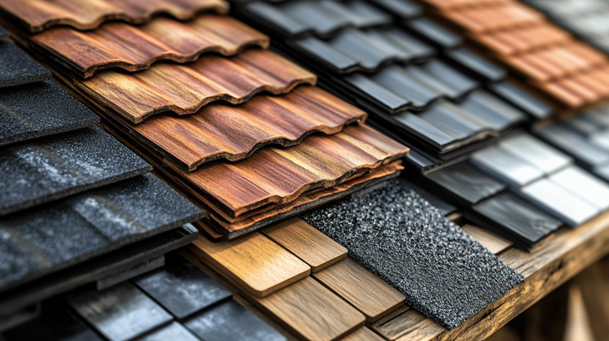

Basic materials
Finishing materials
Roofing materials
Materials to paint a wall
Cement
Sand
Gravel
Bricks or concrete blocks
Reinforcing steel (rods, wire)
Wood (for formwork, structures)
Plaster
Tiles
Paint
Floors (ceramic, wood, etc.)
Doors and windows
Materials for electrical installations
Paint
Brushes or rollers
Painter's tape
Sandpaper
Bucket
Plastic or paper to protect the floor
Spatula.
Roof tiles
Metal sheets
Waterproofing

Slide 7
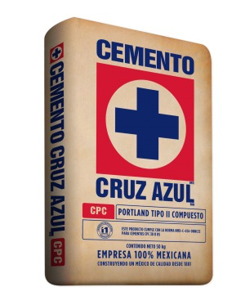
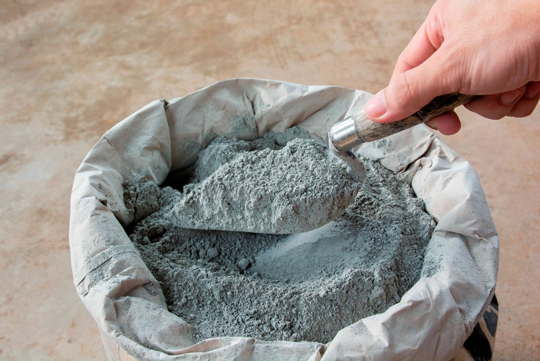
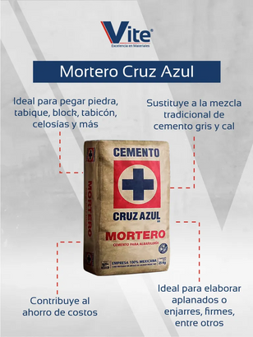

CRUZ AZUL
Product Code: 1173079133
$250
See promotions
Shipments
Amount
FiIn its dry form, cement has a fine powder consistency.
When mixed with water, it forms a paste that hardens and gains strength over time.
The consistency of the cement paste depends on the amount of water used in the mix. Too much water can weaken the cement, while too little can make it difficult to handle.
The consistency of the Cruz Azul cement mix has good plasticity, which makes it easy to handle when working.
-
1
+
Buy now
Add to cart

Slide 8
